Slide 2
STATE SPACE APPROACH
STATE SPACE MODELLING OF SYSTEMS

Slide 3
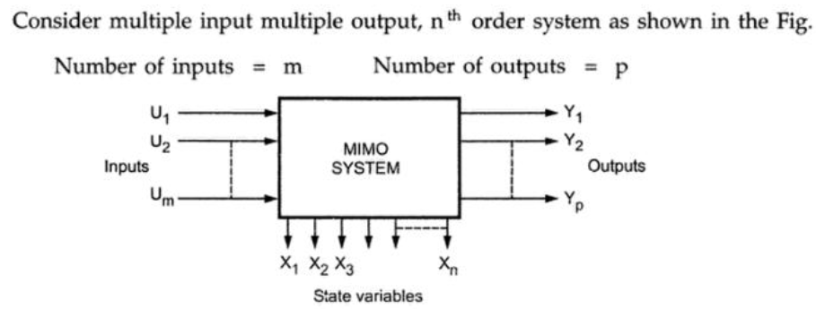

State Model of Linear Systems

Slide 4

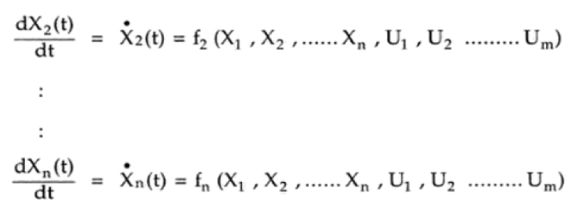
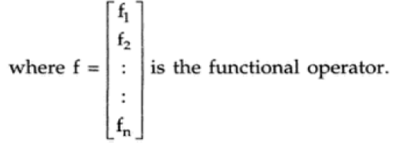
State Model of Linear Systems

Slide 5

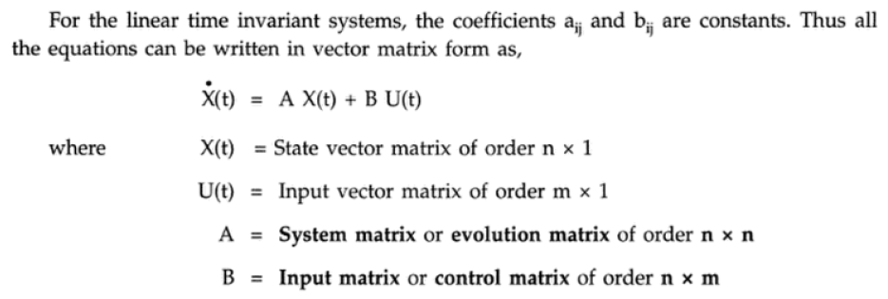
set of derivative of inputs(equations)

Slide 6


For the Output

Slide 7
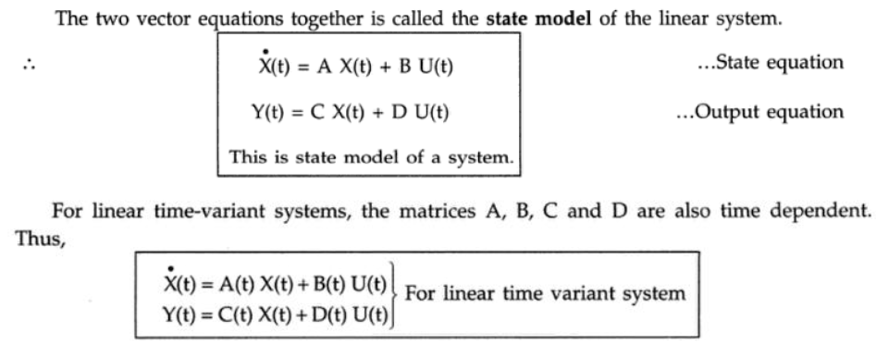
State Model of Linear Systems

Slide 8
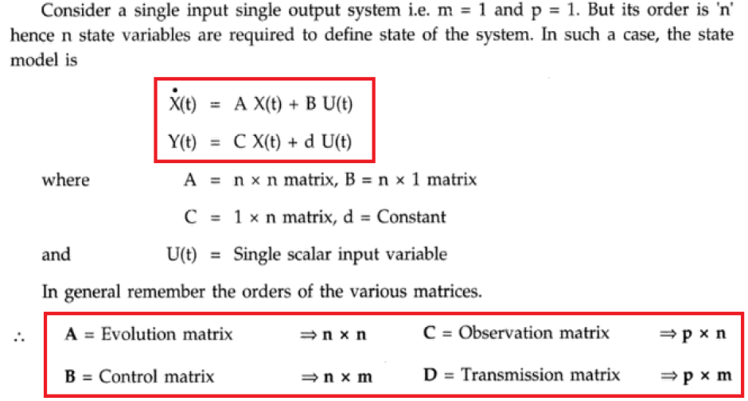
State Model of Linear SISO System

Slide 9

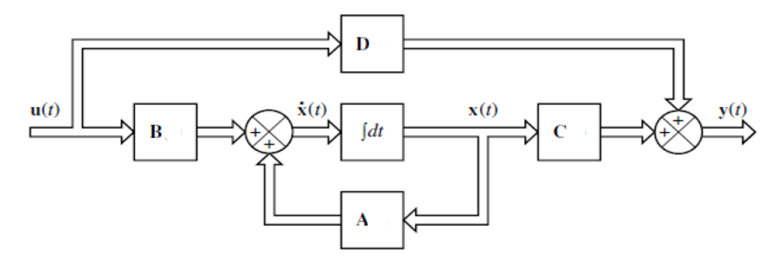
Block Diagram Representation of a Continuous State-Space Model

Slide 10
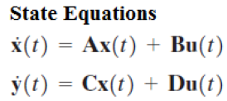

Slide 11

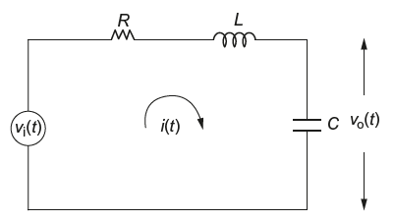
Determine the state-space model for the electrical system shown in Fig.

Slide 12






Consider the state variables as
hence

Slide 13
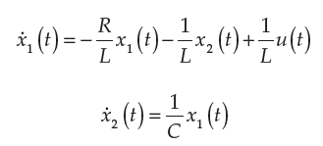
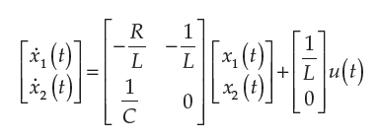
Problems in State Model

Slide 14




Problems in State Model

Slide 16

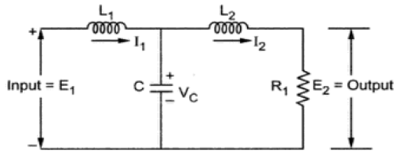
Problems in State Model
Obtain the state-space model of the circuit given

Slide 17
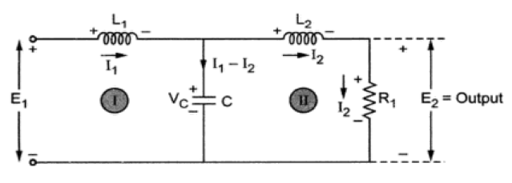
Problems in State Model

Slide 18
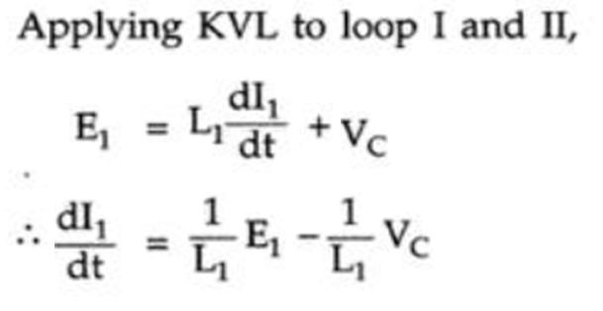

Problems in State Model

Slide 19
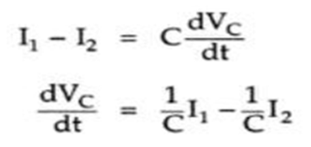
Problems in State Model
The 3rd equation

Slide 20








Problems in State Model

Slide 21






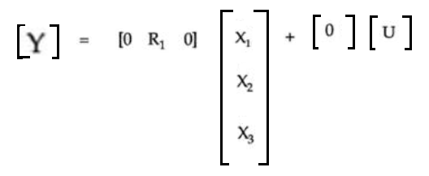
Problems in State Model

Slide 23
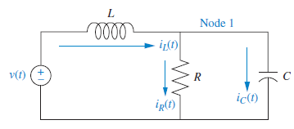
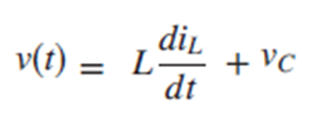

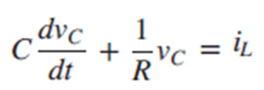

Slide 24
